Slide 1
Aerosols

Slide 2
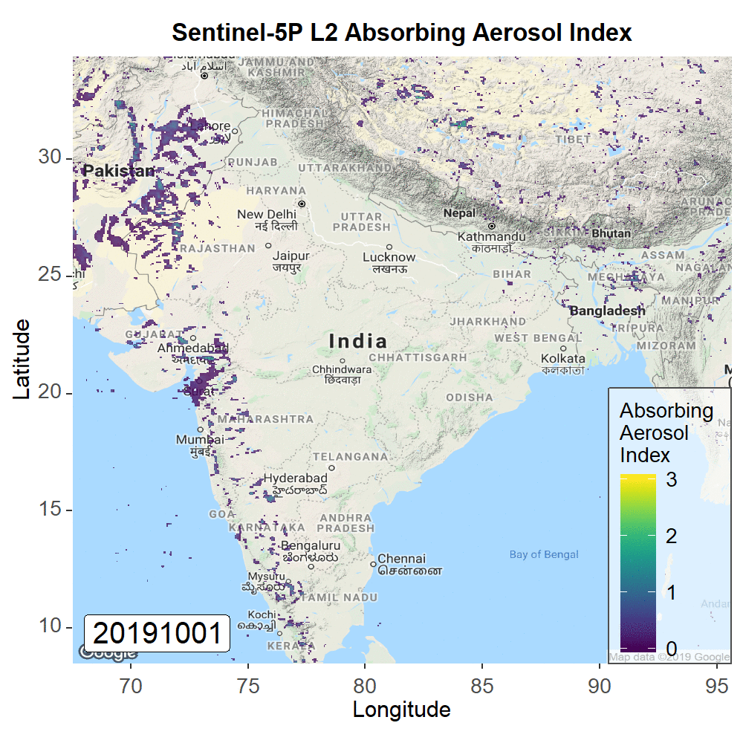

Visualisation S-5P data with CREODIAS
Workflow
Search CREODIAS repository via API (Python)
Input needed: date range, geographical area
On CREODIAS VM no need to download data
Process S-5P data with HARP (Python)
Filter data on validity value
Spatial binning
Export to tiff
Visualisation (R)
Make nice looking plots with base map
Creation animated giff
www.creodias.eu
svanbeijma@cloudferro.com

